Slide 1
COVID-19 Smart Door Using RPi
Malavika Hariprasad
Neha N
Nimisha Dey
Mentor: S G Raghavendra Prasad

Slide 2
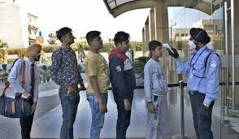

INTRODUCTION
Recent guidelines to prevent COVID-19 from spreading indicate that we must avoid crowded places.
The use of face masks, regular sanitization of hands and temperature screening in public places have become a necessity to curb the further spread of the infection.
Manual checking of temperature and sanitizer is a cumbersome task and difficult to manage in crowded places like shopping malls, college entrances etc. These only lead to long lines which increase the risk of infection.
Automation of this process can reduce crowding in public places.

Slide 3
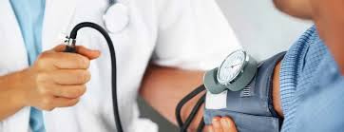
INTRODUCTION
Even in hospitals, checking of vitals like body temperature, SpO2, blood pressure are done manually which takes time and increases unnecessary contact.
With the development of technology, these can be automated to avoid contact and make the process faster.

Slide 4
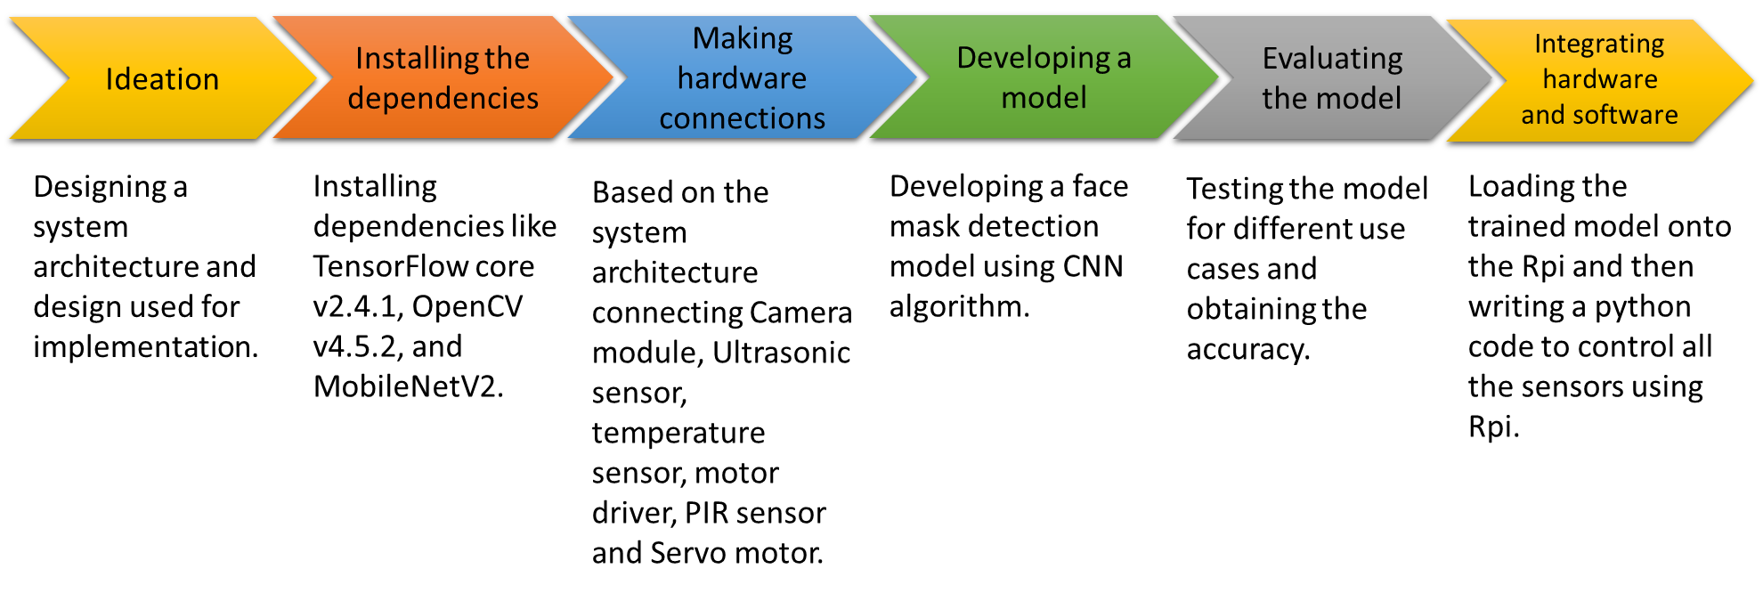
ACTION PLAN

Slide 5
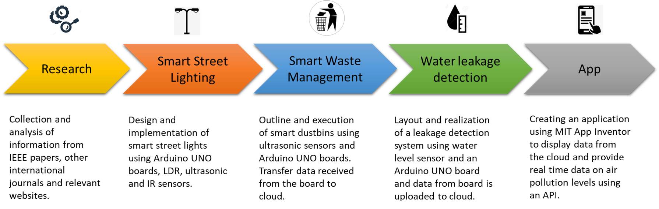
INTRODUCTION

Slide 6
OBJECTIVES
CURRENT:
To design a smart door which performs the important functions:
Face Mask Detection
Contactless Temperature Screening
Automatic Hand Sanitization
User friendly V\visual instructions on LCD Screen
using Raspberry Pi
To develop a user friendly interface using Tkinter library in Python

Slide 7
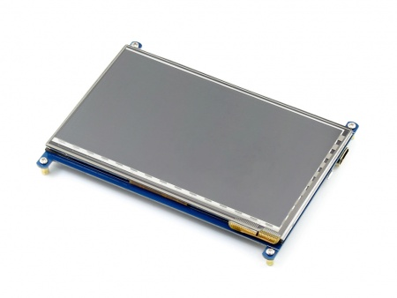
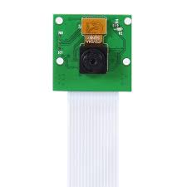
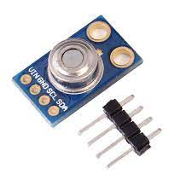
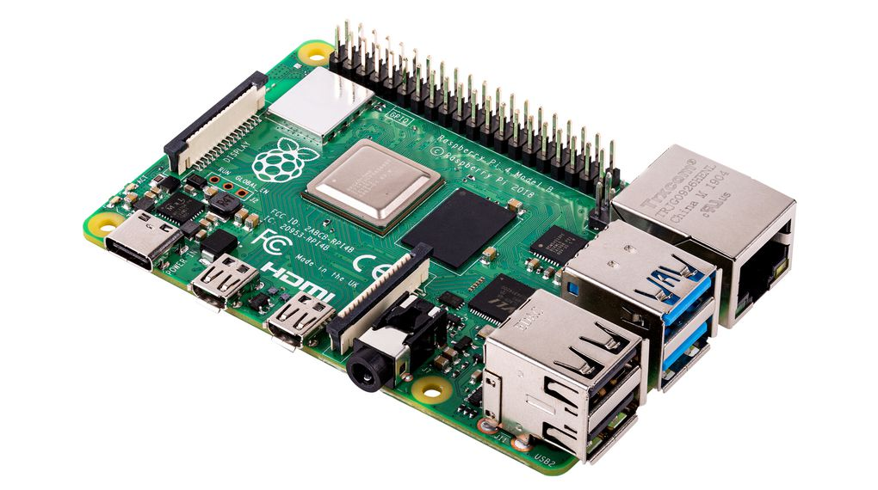
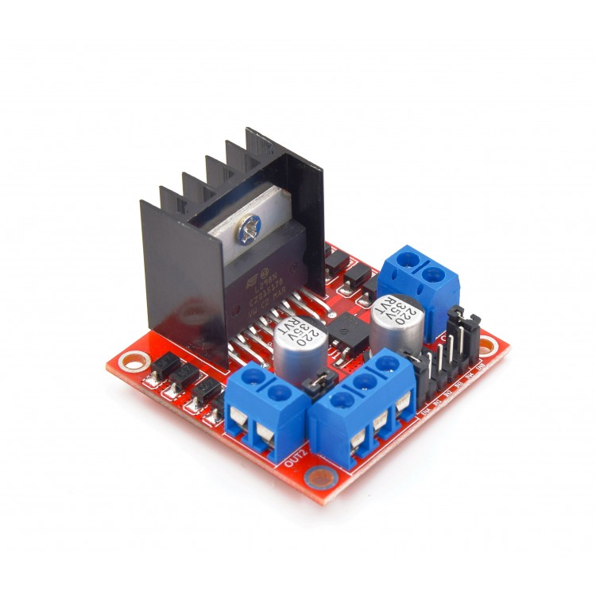
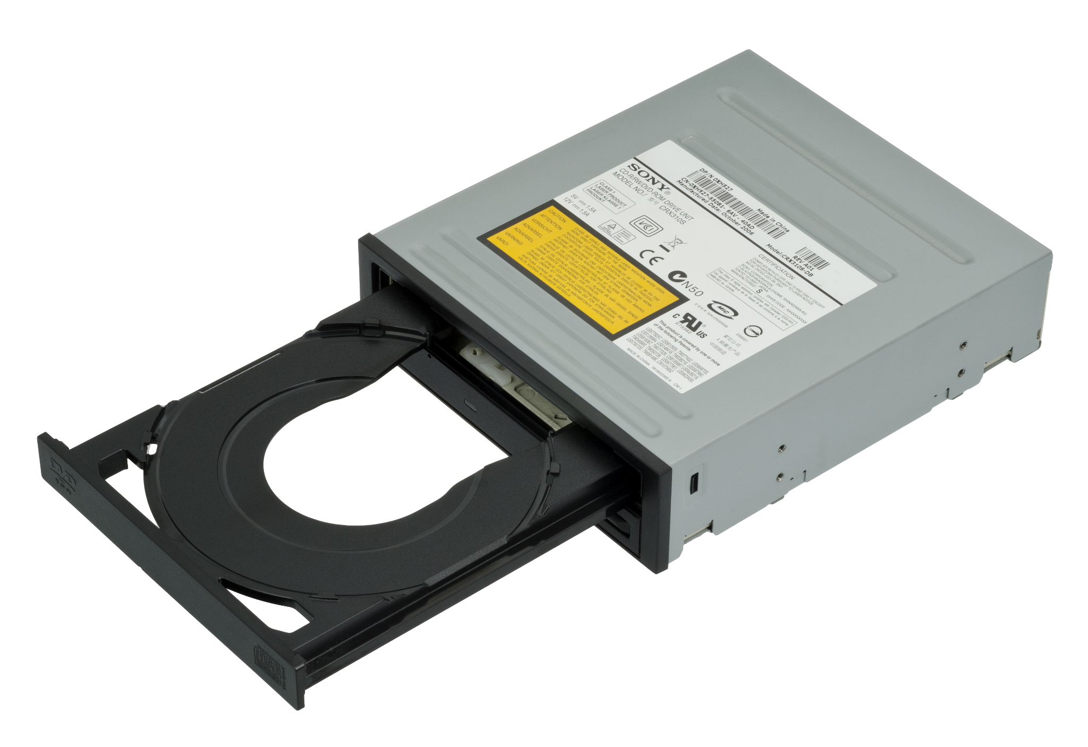
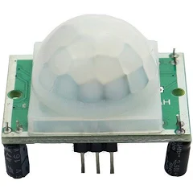
COMPONENTS
RASPBERRY PI
LCD DISPLAY
PI CAMERA
TEMPERATURE SENSOR
MOTOR DRIVER
CD DRIVE
PIR SENSOR

Slide 8
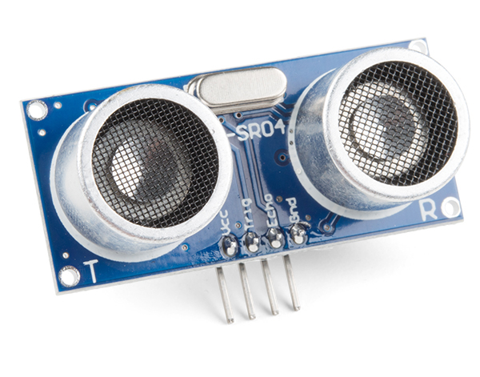





COMPONENTS
ULTRASONIC SENSOR
HAND SANITIZER DISPENSER
SERVO MOTOR
CLOUD
FACE MASK DETECTION MODULE

Slide 9
TECH STACK
Libraries and Dependencies:
Python 3
TensorFlow core v2.4.1
OpenCV v4.5.2
MobileNetV2
Tkinter library
Numpy
Sk Learn
Cloud:
ThingSpeak Cloud

Slide 10

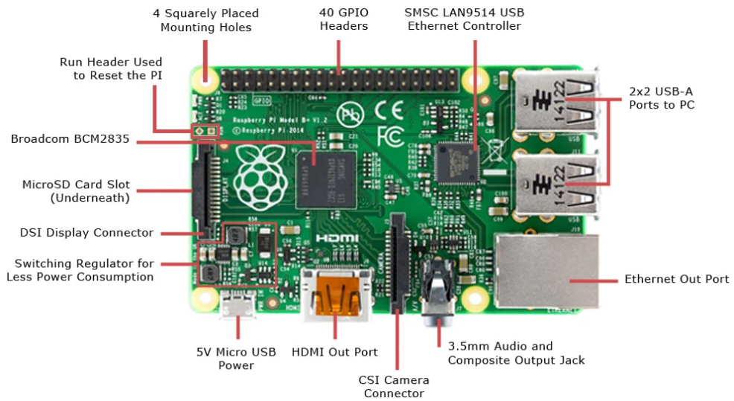
Go, change the world
RV College of
Engineering
RASPBERRY PI
BOARD SPECIFICATION
Quad-Core 1.2GHz Broadcom BCM2837 64bit CPU
1GB RAM
BCM43438 wireless LAN and Bluetooth Low Energy (BLE) on board
100 Base Ethernet
4 USB 2 ports
4 Pole 3.3mm stereo output and composite video port
Full-size HDMI CSI (Camera Serial Interface) camera port for connecting a camera
DSI (Display Serial Interface) display port for connecting a touchscreen display
Micro SD port
Micro USB power port (up to 2.5A)
40-pin extended GPIO

Slide 11
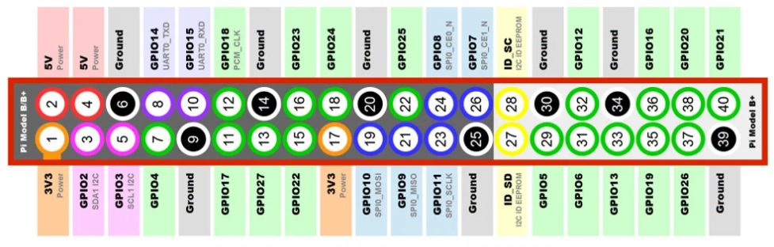
Go, change the world
RV College of
Engineering
RASPBERRY PI
PIN DETAILS AND CONFIGURATION
The raspberry pi 4 consists of 12 power pins - two 5V pins, two 3V3 pins, and 8 ground pins (0V).
5V: The 5v pin outputs the 5 volts coming from the USB Type-C port.
3.3V: The 3v pin is used to provide a stable 3.3v supply to external components.
GND: The ground pin is commonly referred to as GND.
The raspberry pi 4 has 28 GPIO pins (GPIO 0 - GPIO 27)
A pin that can be set as an input or output and is controlled in run time is called a GPIO pin. A GPIO pin set as input allows the signal transmitted by any external device to be received by the Raspberry Pi. Input voltage between 1.8V and 3.3V is read as HIGH by the Raspberry pi. And when the input voltage is lower than 1.8V, it is read as LOW. A GPIO pin set as output delivers HIGH/3.3V or LOW/0V.
Apart from Input/Output, the GPIO pins can also perform a variety of other functions like. Some of these functions/pins are:
PWM pins
SPI pins
I2C pins
UART pins

Slide 12
Go, change the world
RV College of
Engineering
RASPBERRY PI
PIN DETAILS AND CONFIGURATION
PWM pins
PWM stands for “Pulse Width Modulation”. It means that an analog value is being modulated on a digital signal.
Software PWM is available on all pins.
Hardware PWM is available on these pins only: GPIO12, GPIO13, GPIO18, GPIO19
SPI pins
SPI (Serial Peripheral Interface) is a type of serial communication protocol. It is used by the Raspberry Pi for master-slave communication to quickly communicate between one or more peripheral devices.
5 pins are required for SPI communication:
• GND: Connect the GND pin from all the slave components and the Raspberry Pi 4 board together.
• SCLK: Clock for SPI communication.
• MOSI: It stands for Master Out Slave In. This pin is used to send data from the master to a slave.
• MISO: It stands for Master In Slave Out. This pin is used to receive data from a slave to the master.
• CE: It stands for Chip Enable. We need to connect one CE pin per slave (or peripheral devices) in our circuit.

Slide 13
Go, change the world
RV College of
Engineering
RASPBERRY PI
PIN DETAILS AND CONFIGURATION
I2C pin
I2C pins on the Raspberry Pi board are used to communicate with peripheral devices that are compatible with Inter-Integrated Circuit (a low-speed two-wire serial communication protocol).
This serial communication protocol requires master-slave roles between both, the board and the peripheral devices.
I2C protocol requires two connections: SDA (Serial Data) and SCL (Serial Clock). They work by transmitting data using the SDA connection, and the speed of data transfer is controlled via the SCLK pin.
UART pins
The UART (Universal Asynchronous Receiver / Transmitter) is an asynchronous protocol that provides a way to communicate between two microcontrollers or devices.
TX pin transmits the serial data to the RX pin of another device and RX pin receives the serial data coming from TX pin of the other device.

Slide 14
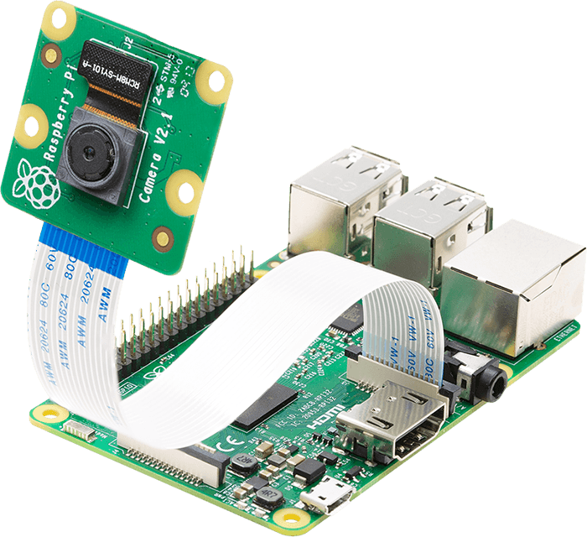
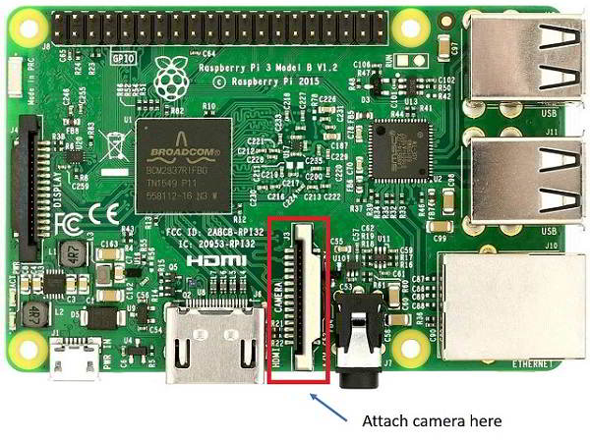
Go, change the world
RV College of
Engineering
PI CAMERA
Pi Camera module is a camera which can be used to take pictures and high definition video.
Raspberry Pi Board has CSI (Camera Serial Interface) interface to which we can attach PiCamera module directly.
This Pi Camera module can attach to the Raspberry Pi’s CSI port using 15-pin ribbon cable.

Slide 15
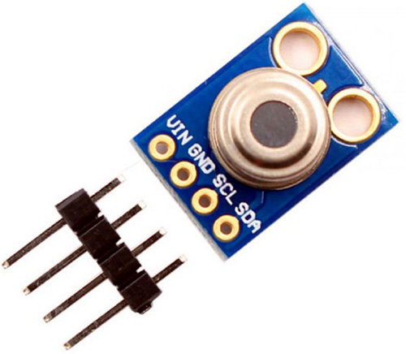
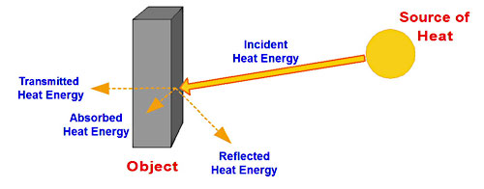
Go, change the world
RV College of
Engineering
TEMPERATURE SENSOR
MLX90614 Temperature Sensor is an infrared contactless temperature measurement device.
Operating Voltage: 3.6V to 5V
Various temperatures measured by this sensor:
Ambient temperature - temperature of the surrounding environment
Ambient temperature range : -70° C to 382.2°C
Object temperature - temperature of an object
Object temperature range: -40° C to 125°C
Pin Name | Description
VCC | Power to the Temperature Sensor
GND | Ground pin
SCL | To control the rate of data transfer
SDA | To transfer data

Slide 16
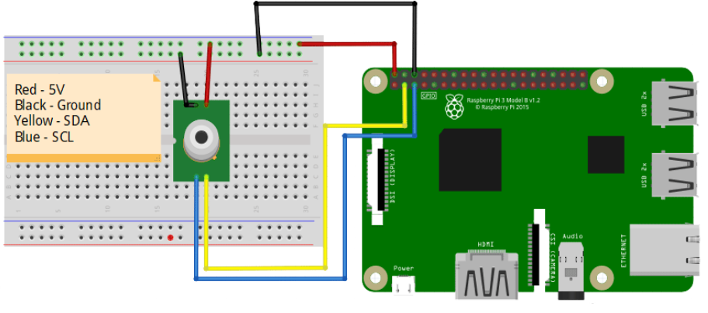
Go, change the world
RV College of
Engineering
TEMPERATURE SENSOR

Slide 17
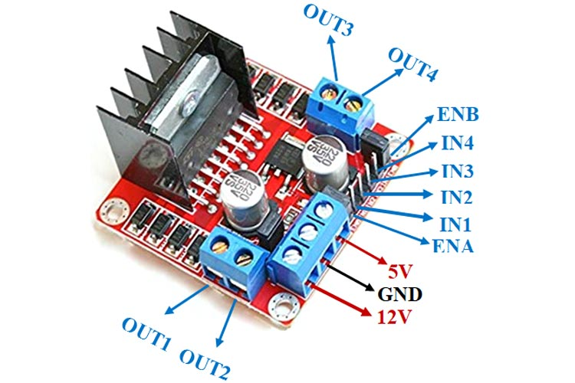
Go, change the world
RV College of
Engineering
MOTOR DRIVER
The L298N is a dual H-Bridge motor driver which allows speed and direction control of two DC motors at the same time. The module can drive DC motors that have voltages between 5 and 35V, with a peak current up to 2A.
The Enable A and Enable B pins are used for enabling and controlling the speed of the motor.
PWM input is can be connected to these pins to control the speed of the motor. If we connect this pin to a Ground the motor will be disabled.
Input 1 and Input 2 pins are used for controlling the rotation direction of the motor A, and the inputs 3 and 4 for the motor B. Using these pins we actually control the switches of the H-Bridge inside the L298N IC.
Pin Name | Description
IN1 & IN2 | Motor A input pins. Used to control the spinning direction of Motor A
IN3 & IN4 | Motor B input pins. Used to control the spinning direction of Motor B
ENA | Enables PWM signal for Motor A
ENB | Enables PWM signal for Motor B
OUT1 & OUT2 | Output pins of Motor A
OUT3 & OUT4 | Output pins of Motor B
12V | 12V input from DC power Source
5V | Supplies power for the switching logic circuitry inside L298N IC
GND | Ground pin

Slide 18
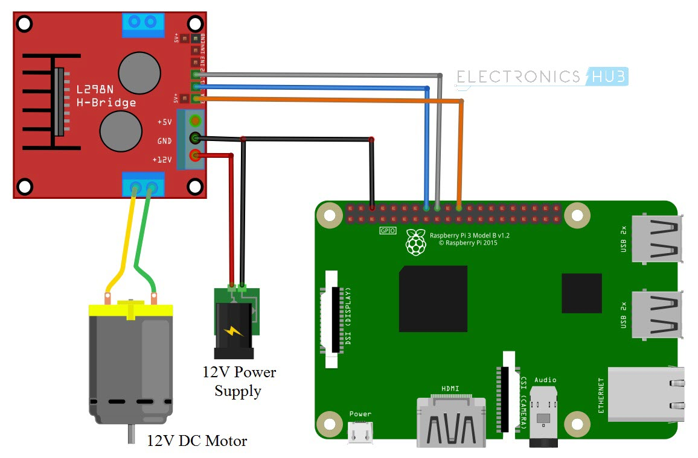
Go, change the world
RV College of
Engineering
MOTOR DRIVER

Slide 19
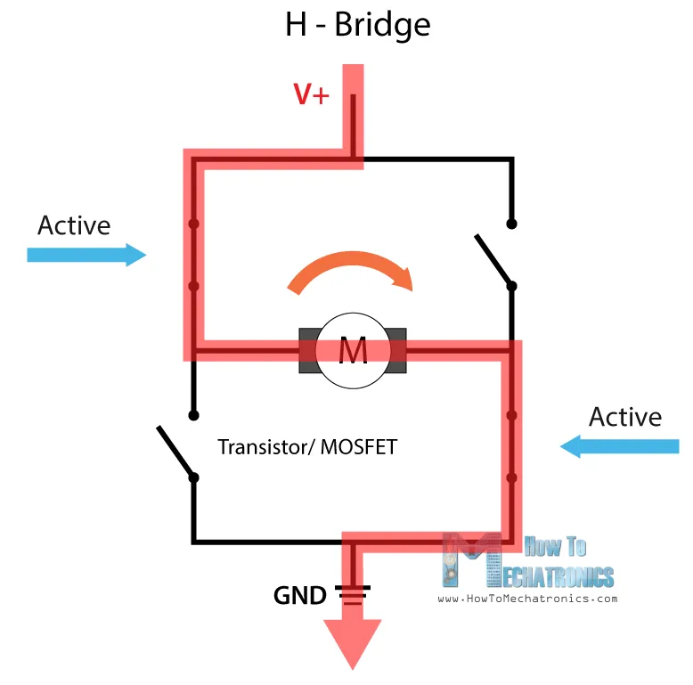
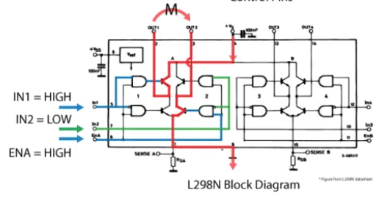
Go, change the world
RV College of
Engineering
MOTOR DRIVER
An H-Bridge circuit contains four switching elements, transistors or MOSFETs, with the motor at the center forming an H-like configuration. By activating two particular switches at the same time we can change the direction of the current flow, thus change the rotation direction of the motor
If input 1 is LOW and input 2 is HIGH the motor will move forward, and vice versa, if input 1 is HIGH and input 2 is LOW the motor will move backward. In case both inputs are same, either LOW or HIGH the motor will stop.

Slide 20
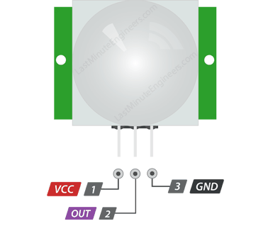
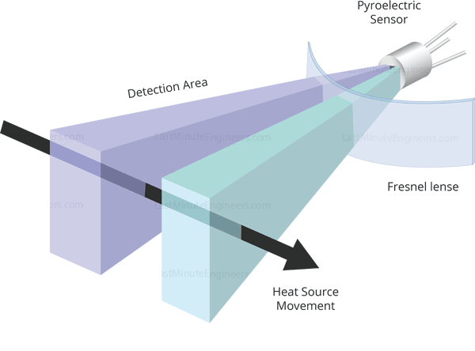

Go, change the world
RV College of
Engineering
PIR SENSOR
Principle: All objects with a temperature above Absolute Zero emit heat energy in the form of infrared radiation, including human bodies. The hotter an object is, the more radiation it emits.
PIR sensor is specially designed to detect such levels of infrared radiation. It has two rectangular slots in it made of a material that allows the infrared radiation to pass. Behind these, are two separate infrared sensor electrodes. If one half sees more or less IR radiation than the other, the output will swing high or low.
Pin Name | Description
VCC | Power to the PIR Sensor
OUT | HIGH or LOW ; HIGH if motion detected; else, LOW
GND | Ground pin

Slide 21
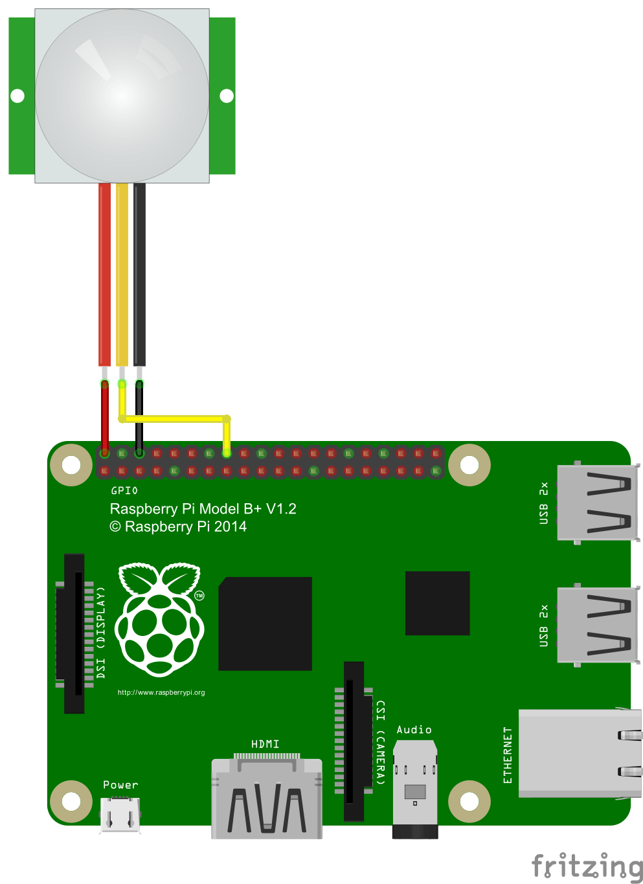
Go, change the world
RV College of
Engineering
PIR SENSOR

Slide 22
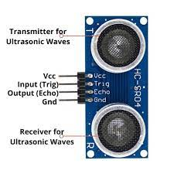
Go, change the world
RV College of
Engineering
ULTRASONIC SENSOR
An ultrasonic sensor is an instrument that measures the distance to an object using ultrasonic sound waves.
An ultrasonic sensor uses a transducer to send and receive ultrasonic pulses that relay back information about an object’s proximity.
The working principle of this module is that it sends an ultrasonic pulse out at 40kHz which travels through the air and if there is an obstacle or object, it will bounce back to the sensor. By calculating the travel time and the speed of sound, the distance can be calculated.
It works on the same principle as RADAR, i.e. sound wave reflection. The radio-frequency (rf) energy is transmitted to and reflected from the reflecting object. The time taken for this is recorded and distance is calculated using the formula:
Distance= (time * speed of sound)/2
Pin Name | Description
VCC | Power to ultrasonic sensor
GND | Ground pin
TRIG pin | Input pin
ECHO pin | Output pin

Slide 23
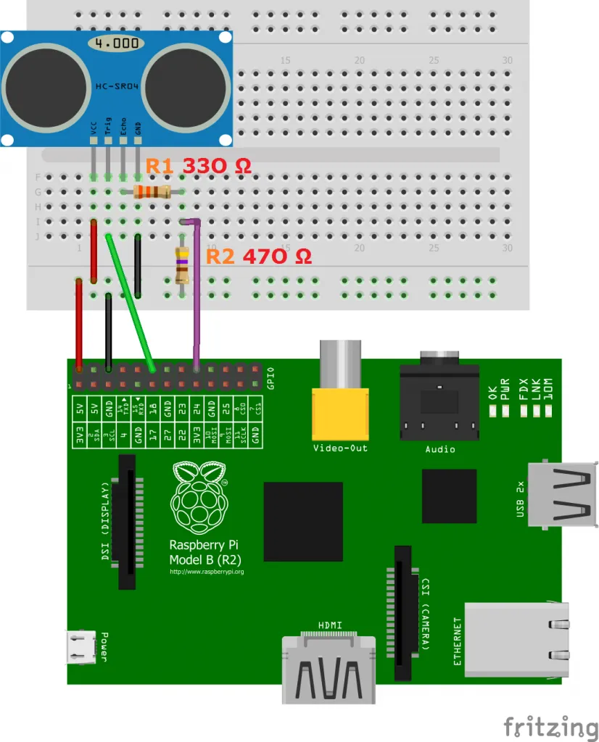
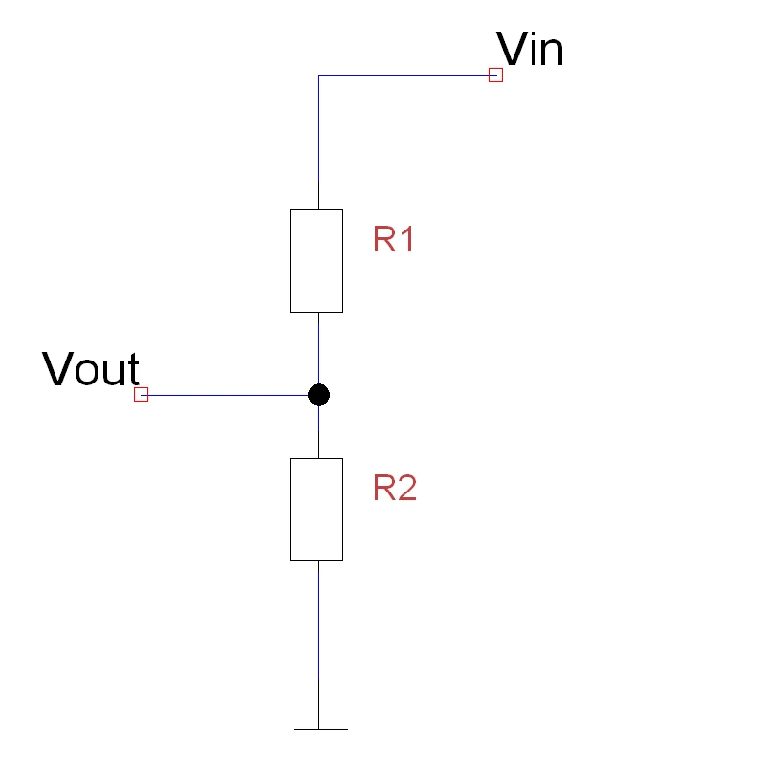
Go, change the world
RV College of
Engineering
ULTRASONIC SENSOR
The resistors are used to reduce the output of the ECHO pin from 5V to 3.3V since the GPIO pins of the RPi can handle only a maximum of 3.3V.
It follows the basic principle of a voltage divider circuit.

Slide 24
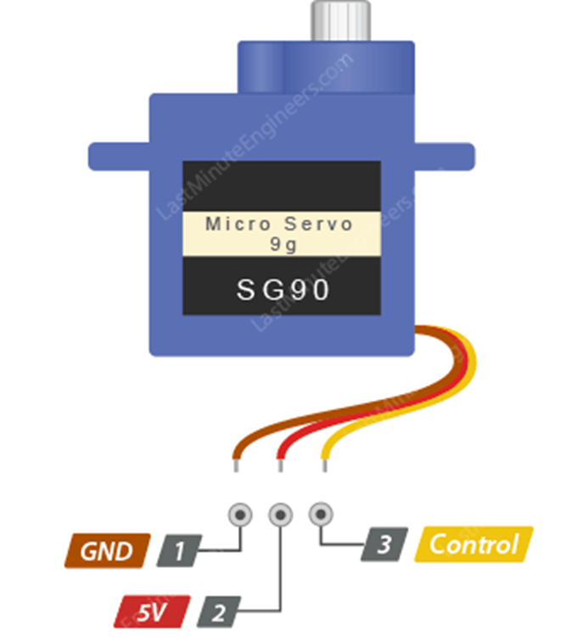
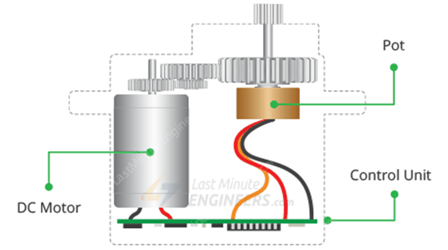
Go, change the world
RV College of
Engineering
SERVO MOTOR
•Servo is a general term for a closed loop control system.
•A closed loop control system uses the feedback signal to adjust the speed and direction of motor to achieve the desired result.
•RC servo motor works on the same principal. It contains a small DC motor connected to the output shaft through the gears.
•The output shaft drives a servo arm and is also connected to a potentiometer (pot)
•The potentiometer provides position feedback to the servo control unit where the current position of the motor is compared to the target position.
•According to the error, the control unit corrects the actual position of the motor so that it matches the target position.
Pin Name | Description
VCC | Power to servo motor
GND | Ground pin
Control | Input pin

Slide 25
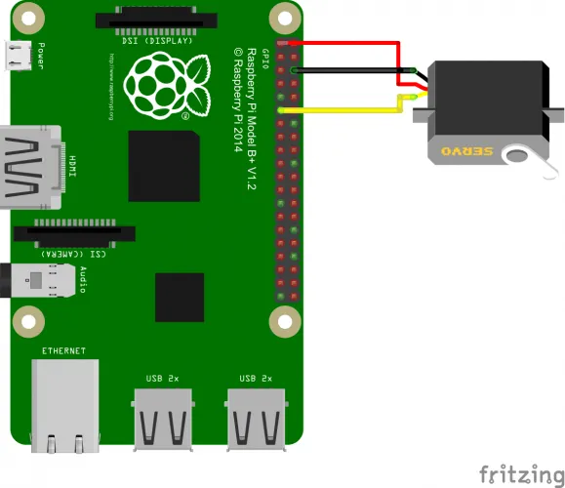
Go, change the world
RV College of
Engineering
SERVO MOTOR
The colors of the servo are as follows and are connected to the Pi:
Black – comes to GND (pin 6) from the Pi
Red – comes to 3V3 (pin 1) from the Pi
Yellow/Orange – to a free GPIO pin (e.g., GPIO17, pin 11)

Slide 26
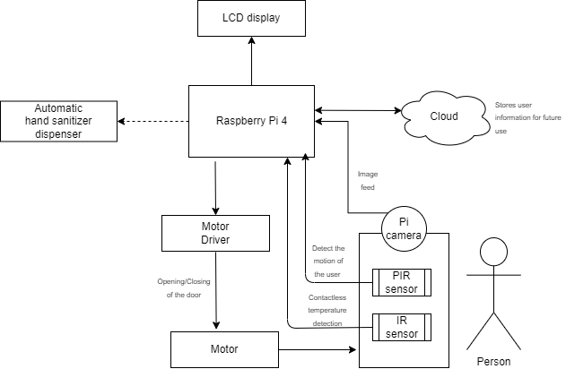
METHODOLOGY

Slide 27
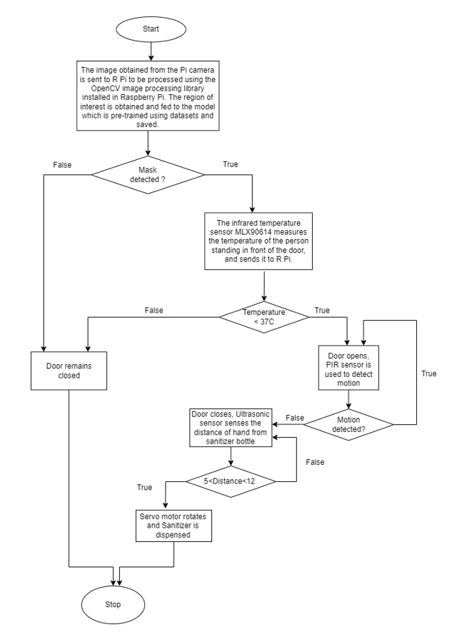
METHODOLOGY

Slide 28
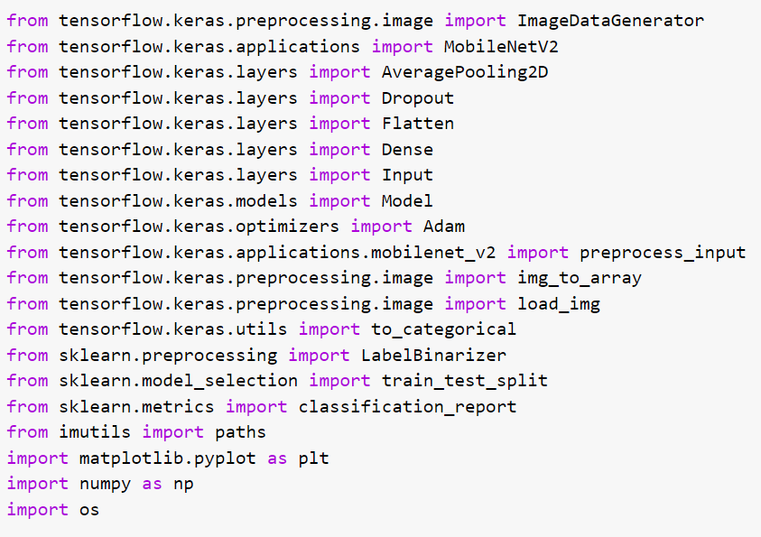
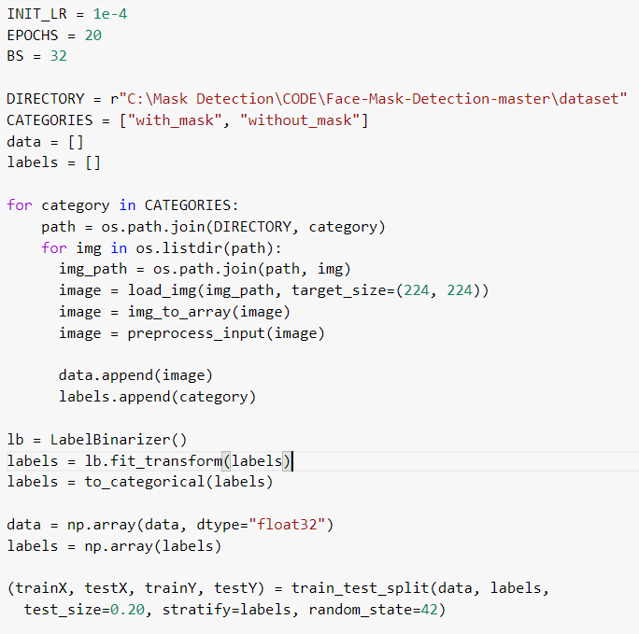
Go, change the world
RV College of
Engineering
Proteus software - MASK DETECTION
Loading the needed Libraries
Creating the dataset

Slide 29
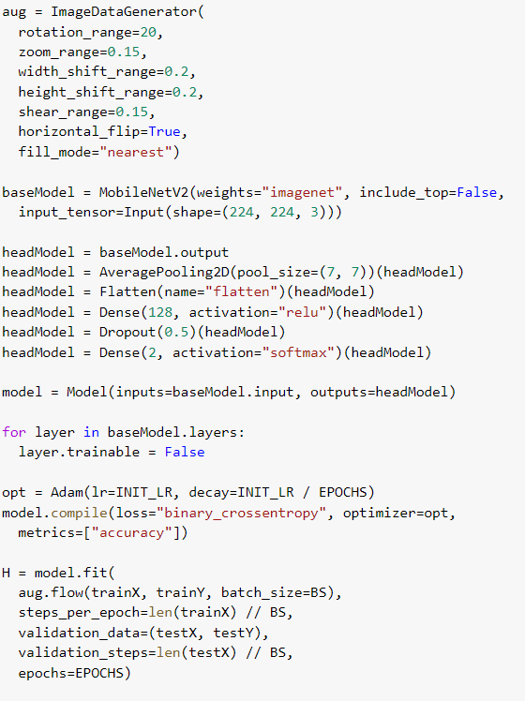
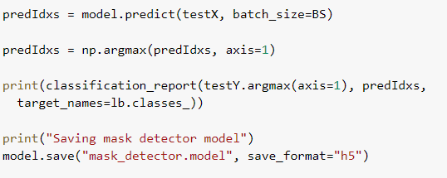
Go, change the world
RV College of
Engineering
Proteus software - MASK DETECTION
Training and creating the model

Slide 30
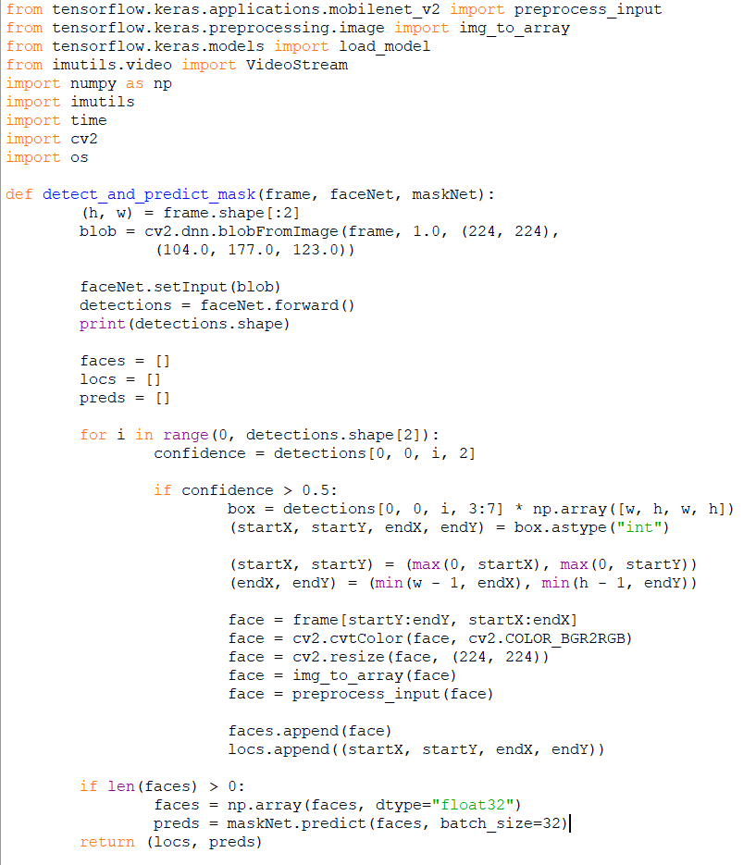
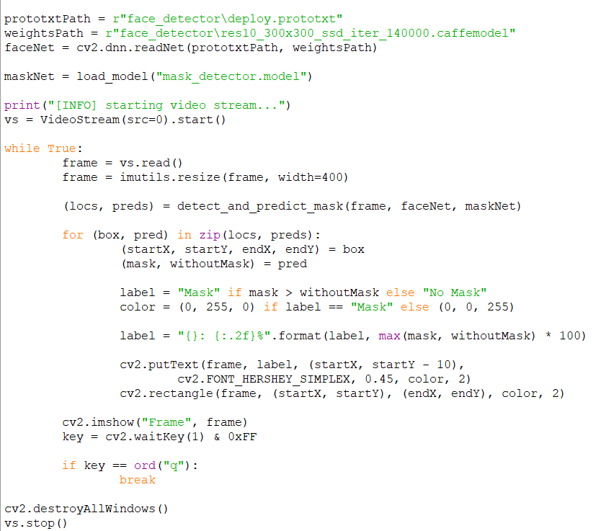
Go, change the world
RV College of
Engineering
Proteus software - MASK DETECTION USING RPi VIDEO

Slide 31
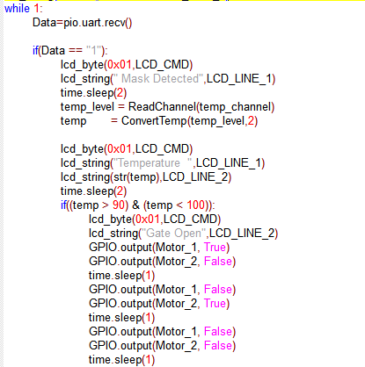
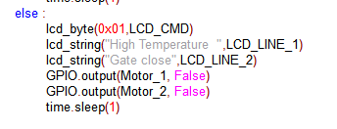
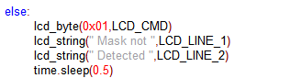
Go, change the world
RV College of
Engineering
PROTEUS CODE FOR THE SMART DOOR
If mask is detected:
If temperature is in the range:
If temperature is not in the range:
If mask is not detected:

Slide 32
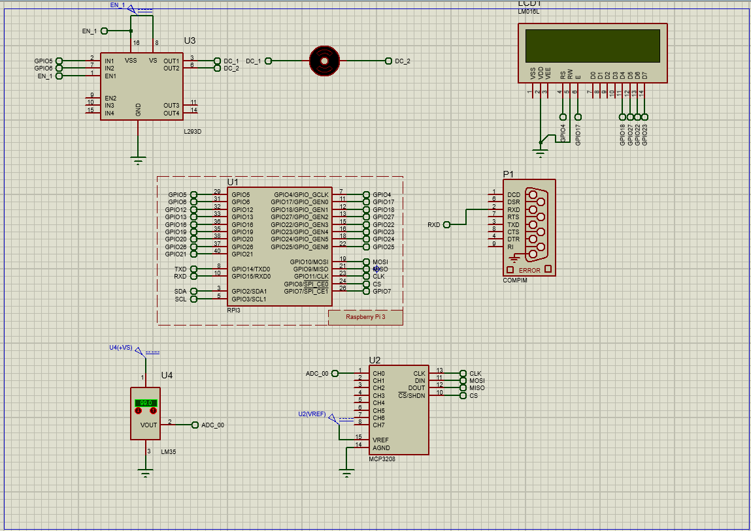
Hardware Connections on Proteus

Slide 33
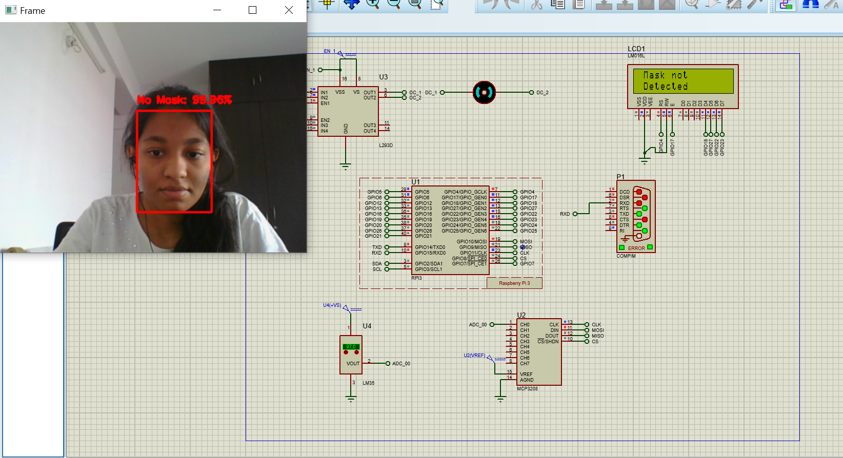
Proteus Simulation

Slide 34
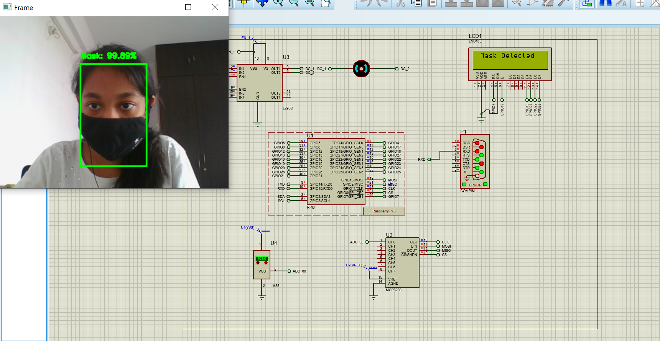
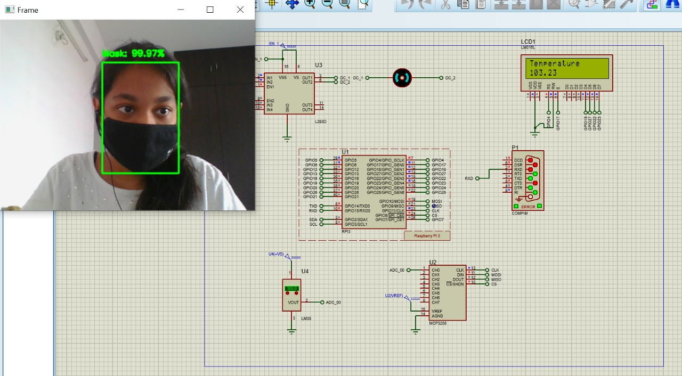
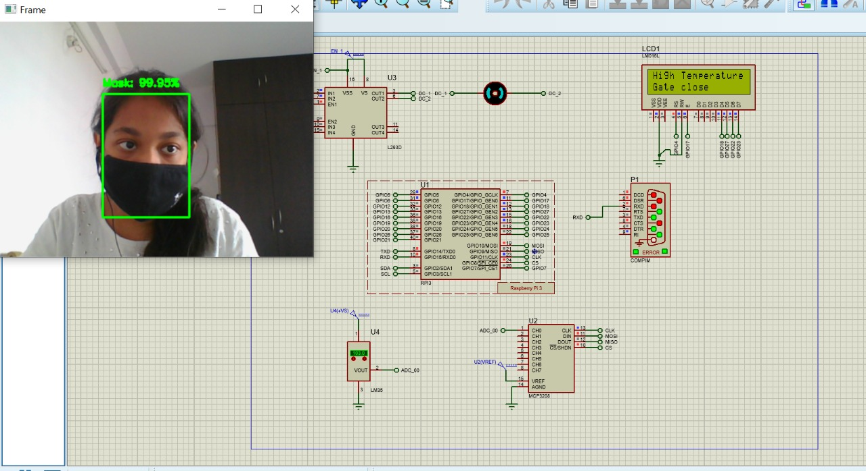
Proteus Simulation

Slide 35
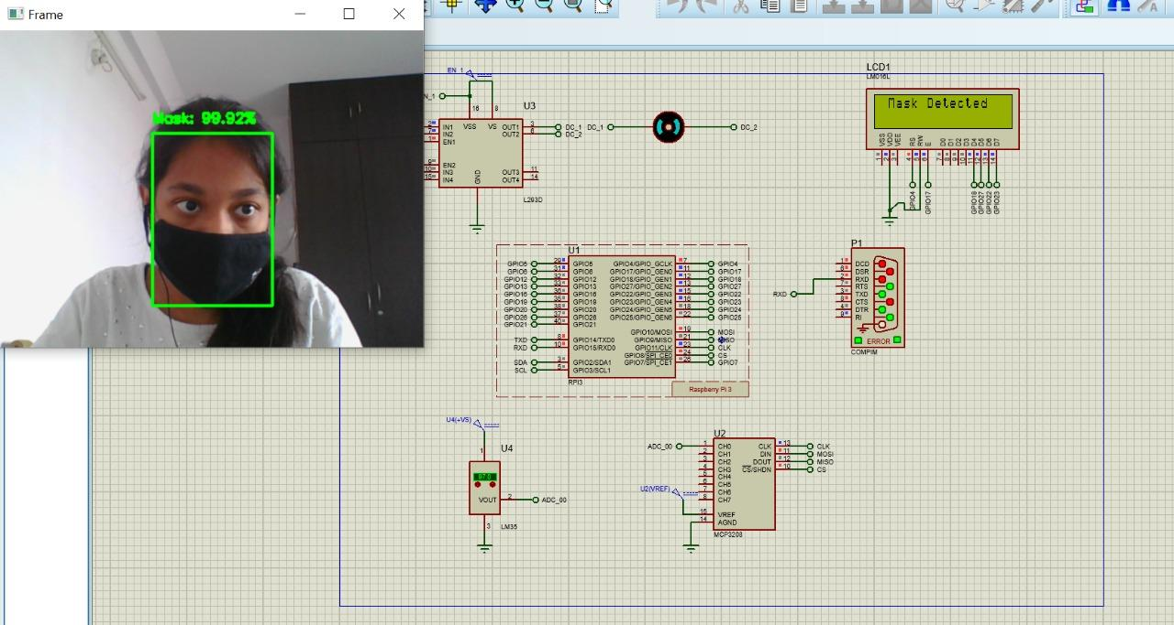
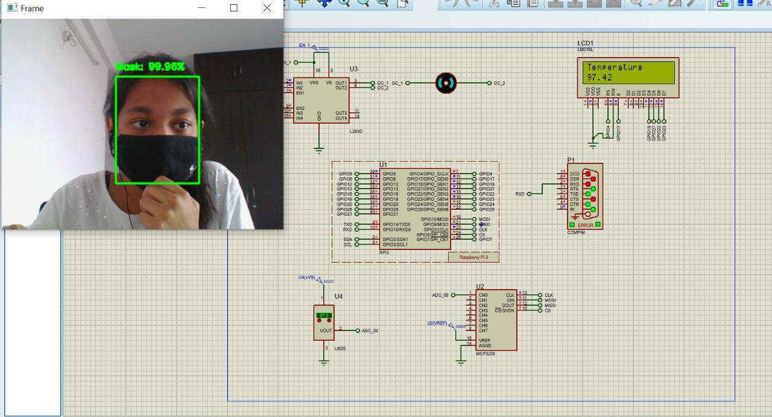

Proteus Simulation

Slide 36
Go, change the world
RV College of
Engineering
Rpi CODE

Slide 37

Hardware Connections - Circuit Diagram

Slide 38

Go, change the world
RV College of
Engineering
Hardware Connections

Slide 39

Go, change the world
RV College of
Engineering
Sending Temperature Data to the ThingSpeak Cloud

Slide 40
Go, change the world
RV College of
Engineering
THINGSPEAK CLOUD

